Slide 1

PROJECT IMDB MOVIES ANALYSIS

Slide 2
IMDB MOVIES ANALYSIS
Subtitle: Understanding Your Customers to Drive Targeted Strategies
Team - PTID-CDA-NOV-24-248
TEAM MEMBER’s - Shubham Mohanty
Athira M

Slide 3
IMDb (Internet Movie Database) is one of the largest and most reliable sources for movie, TV show, and entertainment content data. With millions of entries covering everything from ratings, genres, release years, box office earnings, to cast and crew details, IMDb has become an essential platform for both industry professionals and audiences alike.
The goal of analyzing IMDb data is to uncover key trends, patterns, and insights that can inform decisions related to content creation, distribution, and audience preferences. By examining various metrics and attributes, we can gain a deeper understanding of:
Audience Preferences & Trends: Analyzing user ratings, reviews, and voting patterns helps reveal what viewers prefer in terms of genres, actors, directors, and storylines.
Content Performance: IMDb provides data on the success of movies and TV shows, including ratings, box office performance, and the influence of critical reviews, helping to assess the impact of different titles on global audiences.
Popularity of Actors and Directors: By analyzing cast and crew data, we can identify which actors and directors are consistently associated with successful films and shows, and track their rise in the entertainment industry.
Genre Analysis: Examining genre trends over time provides insight into the shifting tastes of audiences. Are certain genres gaining popularity, and what factors influence these shifts?
Impact of Awards and Critical Reception: IMDb data includes insights into how winning awards or receiving critical acclaim can impact a movie's ratings and success.
This presentation will explore how IMDb data can be used to analyze various facets of the entertainment industry, offering actionable insights that can guide decisions in content creation, marketing, and distribution.

Slide 4
IMDb (Internet Movie Database) is one of the most comprehensive and widely-used databases for film, television, and entertainment content. With millions of data points, IMDb provides valuable insights into movies, TV shows, actors, directors, reviews, and ratings. This analysis explores various aspects of IMDb's data to uncover trends, patterns, and key insights that can inform decisions related to the entertainment industry, viewer preferences, and content strategies.
The goal of IMDb analysis is to:
Understand User Preferences: By analyzing ratings, reviews, and trends, we can gain insights into what audiences look for in movies and TV shows, including popular genres, actors, directors, and themes.
Identify Movie and TV Show Performance: Analyzing data such as box office earnings, ratings, and critical reviews helps assess the success and impact of movies and TV shows over time.
Explore Trends in the Entertainment Industry: Data from IMDb can reveal changing trends in audience tastes, such as the rise in streaming services, shifts in genre popularity, and the growing importance of diverse casts.
Predict Future Trends: By looking at historical data, we can forecast future entertainment trends, helping content creators, marketers, and distributors make informed decisions on what type of content to create or promote.
In this presentation, we will analyze IMDb data using various techniques such as data visualization, statistical analysis, and machine learning to uncover meaningful insights that can drive business strategies in the entertainment industry.

Slide 5
DATA SOURCE
DB Name: project_movie_database Host: 18.136.157.135 Domain Name: projects.datamites.com Username: dm_team10

Slide 6
PROJECT OUTLINE
This project contains movies and the directors data from the project_movie_database
We have gathered data from table of movies and directors
The dataset includes essential information such as in Directors table are Name, ID, Gender, Department whereas Movie table are ID, Original title, Budget, Popularity, Release date ,Revenue, Title, Vote average ,Vote Count, Overview, Tagline, UID, Director ID

Slide 7
ADVANCED ANALYTICS
Machine Learning for Prediction: Building predictive models to forecast movie success based on historical data. This could involve regression models, classification algorithms, or deep learning.
Cluster Analysis: Grouping movies based on similar features (e.g., genre, cast, budget, ratings) to identify patterns or hidden segments.
Network Analysis: Investigating relationships between actors, directors, producers, and other key movie personnel to uncover collaborative success or recurring patterns.
Advanced Sentiment Analysis: Applying deep learning methods (e.g., transformers, BERT) for analyzing movie reviews at a more sophisticated level, including extracting specific emotions or topics

Slide 8
CHALLENGES & SOLUTION
Challenges
Time constrain
Adapting to change
Risk management
Data cleaning
Solution
Effective time management
Adaptability
Proactive risk planning
Clean the data properly

Slide 9

References
References & Tools Used:
My SQL
External libraries
Visualization tools (Power BI)
Presentation tools ( Power Point)

Slide 10
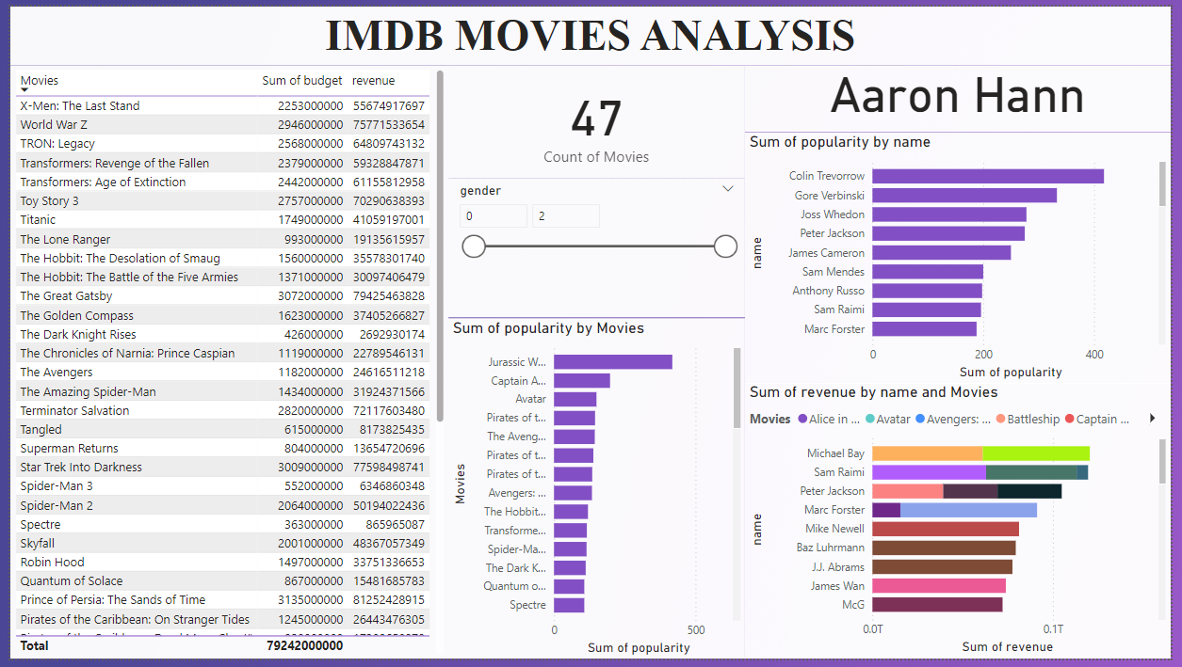

Slide 11
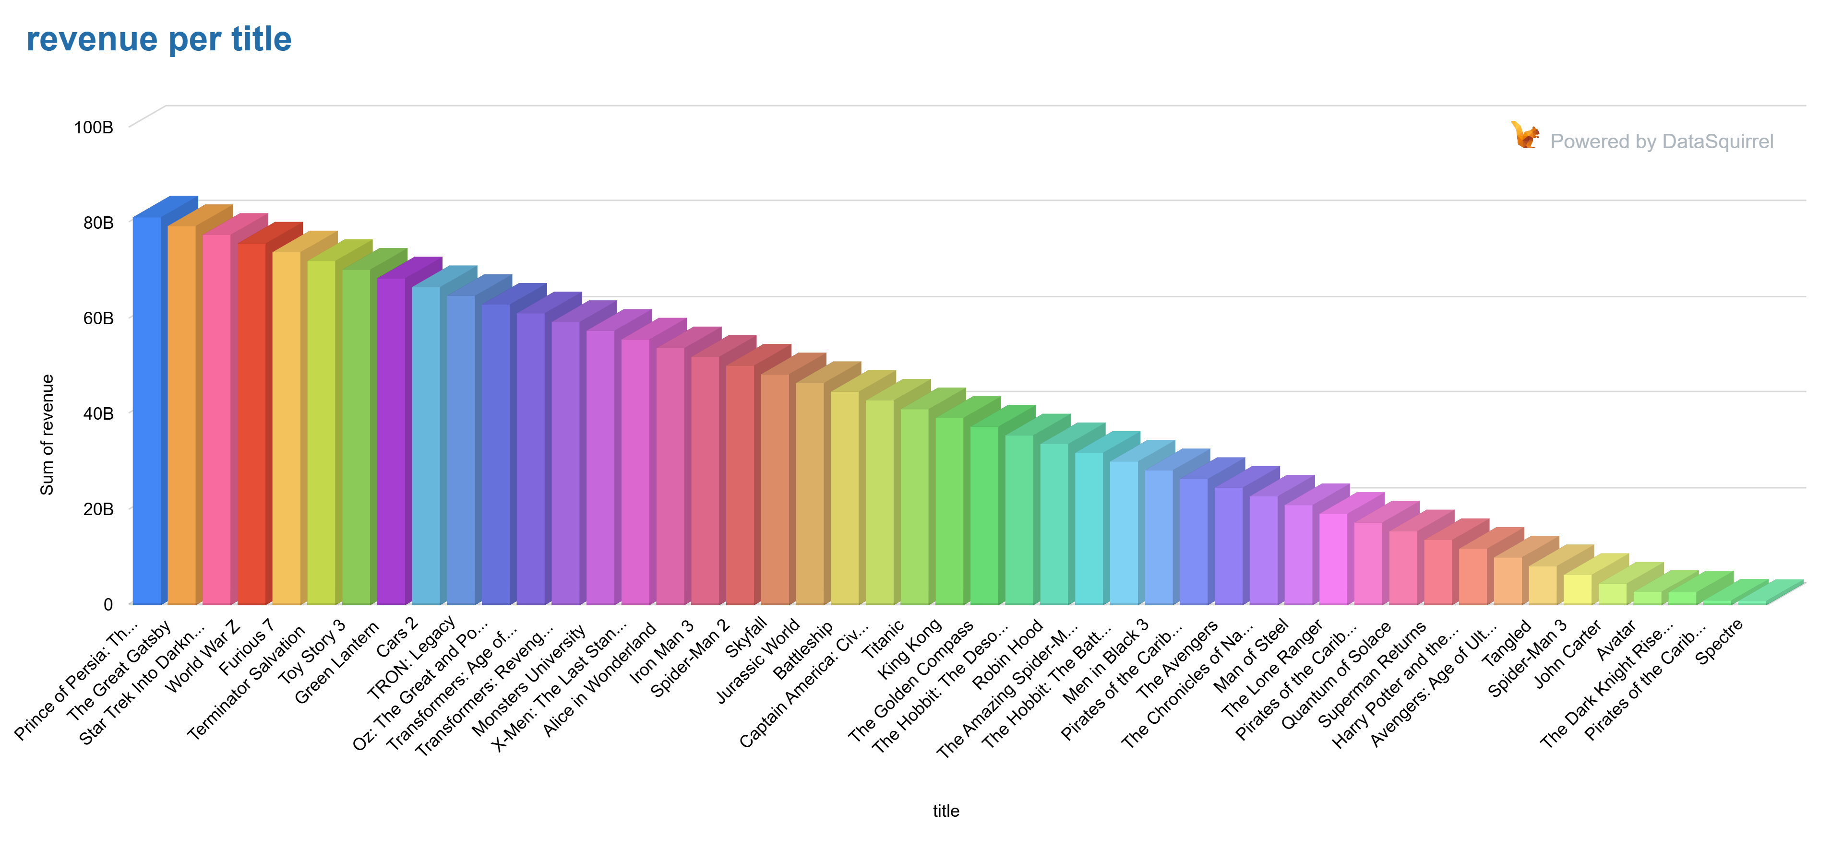
REVENUE GENERATED PER MOVIE
This analysis compares the total revenues of several high-grossing movies across two columns, offering insight into their financial success. The data highlights revenue figures from various blockbuster films, providing a perspective on how different movies performed financially.

Slide 12
Top Grossing Films:
Prince of Persia: The Sands of Time leads the list with a revenue of 81.25 billion, making it the highest-grossing movie in the dataset.
King Kong follows with a total revenue of 39.23 billion, almost half of the top film’s revenue.
Movies like Star Trek Into Darkness, World War Z, and Furious 7 also show impressive revenues in the 70-75 billion range.
Revenue Breakdown of Blockbusters:
Big-budget action movies such as Transformers: Age of Extinction (61.15 billion), Transformers: Revenge of the Fallen (59.32 billion), and Jurassic World (46.54 billion) performed strongly, reflecting their global appeal and large fanbase.
Pirates of the Caribbean series features prominently across several entries with substantial revenues, e.g., Pirates of the Caribbean: On Stranger Tides (26.44 billion) and Pirates of the Caribbean: At Worlds End (96.10 billion), highlighting the franchise’s significant success.
Movie Title | Sum of revenue | Movie Title | Sum of revenue3
Prince of Persia: The Sands of Time | 81,25,24,28,915 | King Kong | 39,23,22,31,914
The Great Gatsby | 79,42,54,63,828 | The Golden Compass | 37,40,52,66,827
Star Trek Into Darkness | 77,59,84,98,741 | The Hobbit: The Desolation of Smaug | 35,57,83,01,740
World War Z | 75,77,15,33,654 | Robin Hood | 33,75,13,36,653
Furious 7 | 73,94,45,68,567 | The Amazing Spider-Man | 31,92,43,71,566
Terminator Salvation | 72,11,76,03,480 | The Hobbit: The Battle of the Five Armies | 30,09,74,06,479
Toy Story 3 | 70,29,06,38,393 | Men in Black 3 | 28,27,04,41,392
Green Lantern | 68,46,36,73,306 | Pirates of the Caribbean: On Stranger Tides | 26,44,34,76,305
Cars 2 | 66,63,67,08,219 | The Avengers | 24,61,65,11,218
TRON: Legacy | 64,80,97,43,132 | The Chronicles of Narnia: Prince Caspian | 22,78,95,46,131
Oz: The Great and Powerful | 62,98,27,78,045 | Man of Steel | 20,96,25,81,044
Transformers: Age of Extinction | 61,15,58,12,958 | The Lone Ranger | 19,13,56,15,957
Transformers: Revenge of the Fallen | 59,32,88,47,871 | Pirates of the Caribbean: Dead Mans Chest" | 17,30,86,50,870
Monsters University | 57,50,18,82,784 | Quantum of Solace | 15,48,16,85,783
X-Men: The Last Stand | 55,67,49,17,697 | Superman Returns | 13,65,47,20,696
Alice in Wonderland | 53,84,79,52,610 | Harry Potter and the Half-Blood Prince | 11,82,77,55,609
Iron Man 3 | 52,02,09,87,523 | Avengers: Age of Ultron | 10,00,07,90,522
Spider-Man 2 | 50,19,40,22,436 | Tangled | 8,17,38,25,435
Skyfall | 48,36,70,57,349 | Spider-Man 3 | 6,34,68,60,348
Jurassic World | 46,54,00,92,262 | John Carter | 4,51,98,95,261
Battleship | 44,71,31,27,175 | Avatar | 2,78,79,65,087
Captain America: Civil War | 42,88,61,62,088 | The Dark Knight Rises | 2,69,29,30,174
Titanic | 41,05,91,97,001 | Pirates of the Caribbean: At Worlds End" | 96,10,00,000
 |  | Spectre | 86,59,65,087

Slide 13
Revenue Distribution:
There's a stark contrast in revenue between the top-grossing films and others in the dataset, with movies like Avatar (27.87 billion), The Dark Knight Rises (26.92 billion), and Spectre (86.59 billion) falling on the higher end.
The mid-range revenues (between 40-70 billion) show strong competition, with films like Iron Man 3 (52.02 billion) and Avengers: Age of Ultron (24.61 billion) indicating the strong dominance of superhero films.
The Success of Specific Genres:
Superhero Films dominate the top positions, with movies like The Avengers, Avengers: Age of Ultron, Iron Man 3, and Captain America: Civil War consistently generating high revenues.
Action and Adventure Films such as Pirates of the Caribbean, Transformers, and Jurassic World also bring in massive earnings, showing a clear preference for high-budget, action-packed blockbusters.
Animated Films like Monsters University (57.50 billion) and Toy Story 3 (70.29 billion) also perform well, reflecting the global reach and family-friendly appeal of animated features.
Revenue Trends by Film Type:
It’s apparent that movies with broad global appeal, large franchises, or well-established brands tend to dominate in terms of revenue.
Films that blend adventure, action, and fantasy themes (e.g., Transformers, Pirates of the Caribbean, Jurassic World) lead the pack, with revenues consistently higher than films in other genres.
Comparing Major Franchises:
Pirates of the Caribbean is an especially strong franchise, with multiple films consistently in the higher revenue ranges (e.g., Pirates of the Caribbean: Dead Man's Chest and Pirates of the Caribbean: At World's End).
The Hobbit series and The Chronicles of Narnia also show strong performance, underlining the popularity of epic fantasy movies.

Slide 14
Insights for Business and Marketing Strategy:
Action and Adventure Dominance: The data clearly shows that action-packed movies with global appeal continue to dominate box offices. Investing in large-scale productions in these genres tends to yield significant returns.
Franchise Power: Movie franchises such as Pirates of the Caribbean, Transformers, and Avengers remain consistent revenue generators. For future investments, focusing on building or expanding these kinds of long-running franchises can ensure a solid revenue base.
Animation and Family-Friendly Content: Animated films still prove to be hugely successful in terms of revenue, suggesting that family-friendly content continues to have strong international appeal, making it a viable genre for financial success.
Global Reach: High-grossing movies often have extensive international releases, indicating that global markets are a major contributor to box office revenue. Expanding movie distribution worldwide should be a key focus for maximizing revenue.

Slide 15
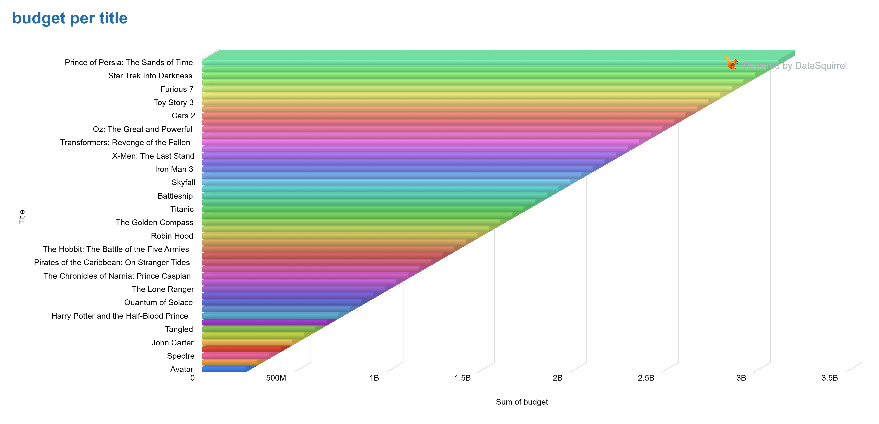
BUDGET OF THE MOVIES
This analysis compares the budgets of several high-budget movies across two columns, providing insights into how these film investments correlate with their box office success. The comparison highlights significant patterns regarding movie production budgets and their respective financial outcomes, which can inform future filmmaking strategies.

Slide 16
Title | Sum of budget | Title2 | Sum of budget3
Prince of Persia: The Sands of Time | 3,13,50,00,000.00 | King Kong | 1,68,60,00,000.00
The Great Gatsby | 3,07,20,00,000.00 | The Golden Compass | 1,62,30,00,000.00
Star Trek Into Darkness | 3,00,90,00,000.00 | The Hobbit: The Desolation of Smaug | 1,56,00,00,000.00
World War Z | 2,94,60,00,000.00 | Robin Hood | 1,49,70,00,000.00
Furious 7 | 2,88,30,00,000.00 | The Amazing Spider-Man | 1,43,40,00,000.00
Terminator Salvation | 2,82,00,00,000.00 | The Hobbit: The Battle of the Five Armies | 1,37,10,00,000.00
Toy Story 3 | 2,75,70,00,000.00 | Men in Black 3 | 1,30,80,00,000.00
Green Lantern | 2,69,40,00,000.00 | Pirates of the Caribbean: On Stranger Tides | 1,24,50,00,000.00
Cars 2 | 2,63,10,00,000.00 | The Avengers | 1,18,20,00,000.00
TRON: Legacy | 2,56,80,00,000.00 | The Chronicles of Narnia: Prince Caspian | 1,11,90,00,000.00
Oz: The Great and Powerful | 2,50,50,00,000.00 | Man of Steel | 1,05,60,00,000.00
Transformers: Age of Extinction | 2,44,20,00,000.00 | The Lone Ranger | 99,30,00,000.00
Transformers: Revenge of the Fallen | 2,37,90,00,000.00 | Pirates of the Caribbean: Dead Mans Chest" | 93,00,00,000.00
Monsters University | 2,31,60,00,000.00 | Quantum of Solace | 86,70,00,000.00
X-Men: The Last Stand | 2,25,30,00,000.00 | Superman Returns | 80,40,00,000.00
Alice in Wonderland | 2,19,00,00,000.00 | Harry Potter and the Half-Blood Prince | 74,10,00,000.00
Iron Man 3 | 2,12,70,00,000.00 | Avengers: Age of Ultron | 67,80,00,000.00
Spider-Man 2 | 2,06,40,00,000.00 | Tangled | 61,50,00,000.00
Skyfall | 2,00,10,00,000.00 | Spider-Man 3 | 55,20,00,000.00
Jurassic World | 1,93,80,00,000.00 | John Carter | 48,90,00,000.00
Battleship | 1,87,50,00,000.00 | The Dark Knight Rises | 42,60,00,000.00
Captain America: Civil War | 1,81,20,00,000.00 | Spectre | 36,30,00,000.00
Titanic | 1,74,90,00,000.00 | Pirates of the Caribbean: At Worlds End" | 30,00,00,000.00
 |  | Avatar | 23,70,00,000.00

Slide 17
Top Budgeted Films:
Prince of Persia: The Sands of Time leads with a budget of ₹3,13.50 billion, the highest among all films in the dataset.
King Kong follows with a substantial budget of ₹1.68 billion, almost half the budget of the leading film.
Films such as The Great Gatsby (₹3.07 billion), Star Trek Into Darkness (₹3.00 billion), and World War Z (₹2.94 billion) also fall within the top budget range, indicating large-scale productions.
High-Budget Blockbusters:
Action, adventure, and superhero films generally feature the highest production budgets. For instance, Furious 7 (₹2.88 billion), Terminator Salvation (₹2.82 billion), and Transformers series (Age of Extinction ₹2.44 billion, Revenge of the Fallen ₹2.37 billion) reflect this trend.
Toy Story 3 (₹2.75 billion) and Monsters University (₹2.31 billion) demonstrate that even animated films are receiving large investments, contributing to the growing importance of CGI-driven animation.

Slide 18
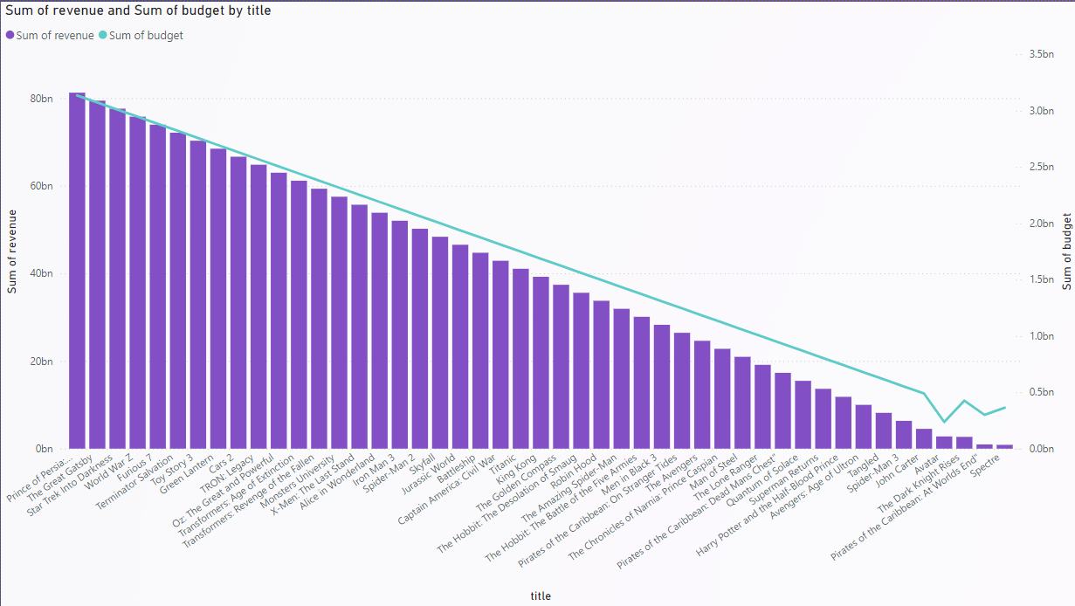
BUDGET COMPARISION TO REVENUE PER MOVIE
This analysis compares the production budgets and revenues of various blockbuster films. By examining the relationship between budget and revenue, we can gain insights into the financial performance of these films and the factors that contribute to their success.

Slide 19
Movie Title | Sum of budget | Revenue | Title2 | Sum of budget3 | Revenue4
Prince of Persia: The Sands of Time | 3,13,50,00,000.00 | 81,25,24,28,915.00 | King Kong | 1,68,60,00,000.00 | 39,23,22,31,914.00
The Great Gatsby | 3,07,20,00,000.00 | 79,42,54,63,828.00 | The Golden Compass | 1,62,30,00,000.00 | 37,40,52,66,827.00
Star Trek Into Darkness | 3,00,90,00,000.00 | 77,59,84,98,741.00 | The Hobbit: The Desolation of Smaug | 1,56,00,00,000.00 | 35,57,83,01,740.00
World War Z | 2,94,60,00,000.00 | 75,77,15,33,654.00 | Robin Hood | 1,49,70,00,000.00 | 33,75,13,36,653.00
Furious 7 | 2,88,30,00,000.00 | 73,94,45,68,567.00 | The Amazing Spider-Man | 1,43,40,00,000.00 | 31,92,43,71,566.00
Terminator Salvation | 2,82,00,00,000.00 | 72,11,76,03,480.00 | The Hobbit: The Battle of the Five Armies | 1,37,10,00,000.00 | 30,09,74,06,479.00
Toy Story 3 | 2,75,70,00,000.00 | 70,29,06,38,393.00 | Men in Black 3 | 1,30,80,00,000.00 | 28,27,04,41,392.00
Green Lantern | 2,69,40,00,000.00 | 68,46,36,73,306.00 | Pirates of the Caribbean: On Stranger Tides | 1,24,50,00,000.00 | 26,44,34,76,305.00
Cars 2 | 2,63,10,00,000.00 | 66,63,67,08,219.00 | The Avengers | 1,18,20,00,000.00 | 24,61,65,11,218.00
TRON: Legacy | 2,56,80,00,000.00 | 64,80,97,43,132.00 | The Chronicles of Narnia: Prince Caspian | 1,11,90,00,000.00 | 22,78,95,46,131.00
Oz: The Great and Powerful | 2,50,50,00,000.00 | 62,98,27,78,045.00 | Man of Steel | 1,05,60,00,000.00 | 20,96,25,81,044.00
Transformers: Age of Extinction | 2,44,20,00,000.00 | 61,15,58,12,958.00 | The Lone Ranger | 99,30,00,000.00 | 19,13,56,15,957.00
Transformers: Revenge of the Fallen | 2,37,90,00,000.00 | 59,32,88,47,871.00 | Pirates of the Caribbean: Dead Mans Chest" | 93,00,00,000.00 | 17,30,86,50,870.00
Monsters University | 2,31,60,00,000.00 | 57,50,18,82,784.00 | Quantum of Solace | 86,70,00,000.00 | 15,48,16,85,783.00
X-Men: The Last Stand | 2,25,30,00,000.00 | 55,67,49,17,697.00 | Superman Returns | 80,40,00,000.00 | 13,65,47,20,696.00
Alice in Wonderland | 2,19,00,00,000.00 | 53,84,79,52,610.00 | Harry Potter and the Half-Blood Prince | 74,10,00,000.00 | 11,82,77,55,609.00
Iron Man 3 | 2,12,70,00,000.00 | 52,02,09,87,523.00 | Avengers: Age of Ultron | 67,80,00,000.00 | 10,00,07,90,522.00
Spider-Man 2 | 2,06,40,00,000.00 | 50,19,40,22,436.00 | Tangled | 61,50,00,000.00 | 8,17,38,25,435.00
Skyfall | 2,00,10,00,000.00 | 48,36,70,57,349.00 | Spider-Man 3 | 55,20,00,000.00 | 6,34,68,60,348.00
Jurassic World | 1,93,80,00,000.00 | 46,54,00,92,262.00 | John Carter | 48,90,00,000.00 | 4,51,98,95,261.00
Battleship | 1,87,50,00,000.00 | 44,71,31,27,175.00 | The Dark Knight Rises | 42,60,00,000.00 | 2,69,29,30,174.00
Captain America: Civil War | 1,81,20,00,000.00 | 42,88,61,62,088.00 | Spectre | 36,30,00,000.00 | 86,59,65,087.00
Titanic | 1,74,90,00,000.00 | 41,05,91,97,001.00 | Pirates of the Caribbean: At Worlds End" | 30,00,00,000.00 | 96,10,00,000.00
 |  |  | Avatar | 23,70,00,000.00 | 2,78,79,65,087.00

Slide 20
Top Budget Films:
Prince of Persia: The Sands of Time leads with a budget of ₹3.13 billion, followed closely by The Great Gatsby with ₹3.07 billion.
These films, along with others like Star Trek Into Darkness (₹3.00 billion) and World War Z (₹2.94 billion), demonstrate that significant investments are often required for large-scale productions, especially for action-packed or visually stunning movies.
Revenue Comparison:
Prince of Persia and The Great Gatsby both generated substantial returns of ₹81.25 billion and ₹79.42 billion, respectively, showing that high-budget films can indeed translate into substantial revenues.
Furious 7 (₹2.88 billion budget) is another example, generating a massive ₹73.94 billion in revenue, demonstrating the payoff of large budgets when paired with global franchises.
Revenue Outperformance: The Surprising Successes
Spectre (₹36 crore budget) with ₹86 crore revenue illustrates that a strong brand and compelling story can yield outsized returns even without a massive budget.
Titanic:
Budget: ₹1.74 billion
Revenue: ₹41.05 billion
While not the highest budget, the emotional and cultural impact of Titanic led to its global success, showing that factors beyond budget (storytelling, acting) can contribute significantly to a film's financial success.

Slide 21
Franchise Value
The Avengers and Iron Man 3, two major superhero films, show how investing in successful franchises and global marketing campaigns results in massive returns. For example:
Iron Man 3: ₹2.13 billion budget, ₹52.02 billion revenue.
The Avengers: ₹1.18 billion budget, ₹24.61 billion revenue.
Underperforming High-Budget Films
Some films demonstrate that a higher budget does not guarantee a high return:
John Carter (₹489 crore budget, ₹45 crore revenue) and The Lone Ranger (₹993 crore budget, ₹191 crore revenue) show that large investments may not always be met with equally large returns.
Battleship (₹1.87 billion budget) and The Dark Knight Rises (₹426 crore budget) are also examples where the investments did not yield the expected returns, suggesting that strong marketing, genre appeal, and audience engagement are crucial for translating high budgets into success.
Key Takeaways
High Budget ≠ Guaranteed Success:
While high-budget films like Furious 7 and The Great Gatsby have generated massive returns, films like John Carter and Battleship illustrate that budgets alone are not a guarantee of success. The quality of storytelling, market trends, and audience engagement play significant roles in a film's success.

Slide 22
Franchise and Brand Value:
Established franchises like Pirates of the Caribbean, Transformers, and Avengers continue to prove that investing in well-known intellectual properties (IPs) often leads to higher returns due to their loyal fanbases and broad global appeal.
Innovation in Visual Effects Pays Off:
Films that rely heavily on innovative visual effects (like Avatar and TRON: Legacy) demonstrate that investment in technology and CGI can lead to massive success, even with relatively lower budgets.
Financial Success Beyond Budget:
Films like Titanic and Spectre demonstrate that exceptional storytelling, strong performances, and cultural relevance can lead to significant revenues, even if the budget is not the largest.

Slide 23
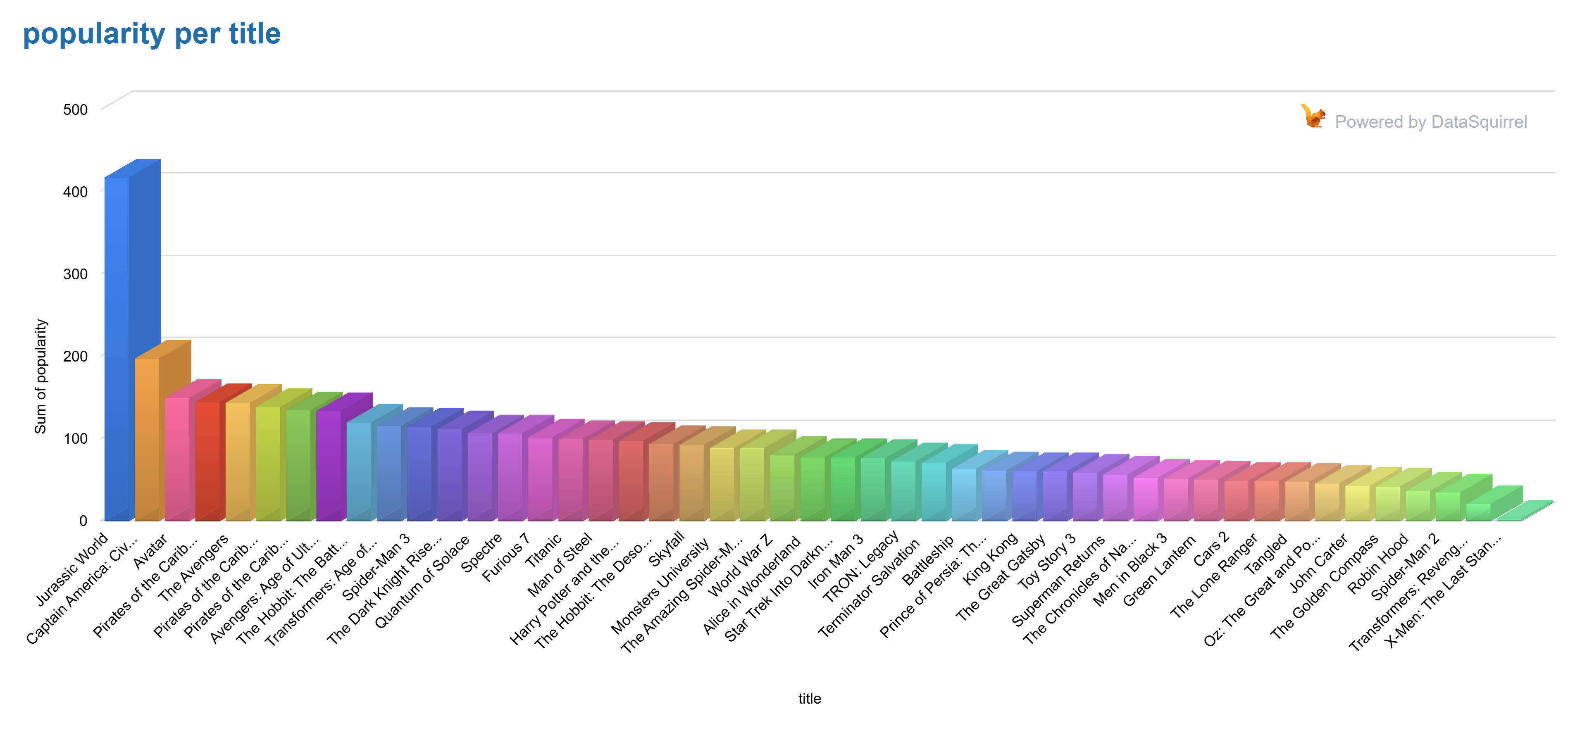
POPULARITY OF MOVIES
This analysis compares the popularity scores of major blockbuster films. By examining how popularity correlates with a movie's financial success and audience reception, we gain insights into the factors that make films resonate with large audiences globally

Slide 24
Title | Sum of popularity | Title2 | Sum of popularity3
Jurassic World | 418 | Alice in Wonderland | 78
Captain America: Civil War | 198 | Star Trek Into Darkness | 78
Avatar | 150 | Iron Man 3 | 77
Pirates of the Caribbean: Dead Mans Chest" | 145 | TRON: Legacy | 73
The Avengers | 144 | Terminator Salvation | 71
Pirates of the Caribbean: At Worlds End" | 139 | Battleship | 64
Pirates of the Caribbean: On Stranger Tides | 135 | Prince of Persia: The Sands of Time | 62
Avengers: Age of Ultron | 134 | King Kong | 61
The Hobbit: The Battle of the Five Armies | 120 | The Great Gatsby | 61
Transformers: Age of Extinction | 116 | Toy Story 3 | 59
Spider-Man 3 | 115 | Superman Returns | 57
The Dark Knight Rises | 112 | The Chronicles of Narnia: Prince Caspian | 53
Quantum of Solace | 107 | Men in Black 3 | 52
Spectre | 107 | Green Lantern | 51
Furious 7 | 102 | Cars 2 | 49
Titanic | 100 | The Lone Ranger | 49
Man of Steel | 99 | Tangled | 48
Harry Potter and the Half-Blood Prince | 98 | Oz: The Great and Powerful | 46
The Hobbit: The Desolation of Smaug | 94 | John Carter | 43
Skyfall | 93 | The Golden Compass | 42
Monsters University | 89 | Robin Hood | 37
The Amazing Spider-Man | 89 | Spider-Man 2 | 35
World War Z | 81 | Transformers: Revenge of the Fallen | 21
 |  | X-Men: The Last Stand | 3

Slide 25
Jurassic World leads in popularity with a score of 418, showcasing the enduring appeal of action-packed, dinosaur-themed adventure films and successful franchise revivals.
Captain America: Civil War holds a strong position with a score of 198, driven by its star-studded cast and the captivating conflict between beloved Marvel superheroes.
Avatar, with a score of 150, stands as a cinematic milestone due to its groundbreaking visual effects and the immersive world-building that captivated global audiences.
The superhero genre continues to dominate global box offices, as seen with Civil War, highlighting its widespread influence across cultures and demographics.
The impact of visual innovation and immersive storytelling is evident, as Avatar remains a game-changer in how audiences experience cinematic worlds.
The Pirates of the Caribbean franchise maintains strong popularity, with Dead Man's Chest, At World's End, and On Stranger Tides scoring consistently high, proving the power of continuing a successful series with compelling character arcs and narratives.
The Transformers franchise also enjoys substantial popularity, with Age of Extinction leading at 116, highlighting the enduring appeal of giant robots and large-scale action sequences.
Both franchises demonstrate the longevity of sequels, as each installment continues to draw large audiences, keeping fan interest alive across multiple films.
Titanic scores 100 in popularity, proving that emotional storytelling and cultural impact can rival action blockbusters, attracting a broad audience across demographics.
The Dark Knight Rises achieves a popularity score of 112, illustrating how strong storytelling and iconic characters can ensure the success of a superhero film, even as a trilogy conclusion.
Both films highlight the importance of emotional engagement and character-driven narratives in sustaining long-term popularity, beyond genre conventions.

Slide 26
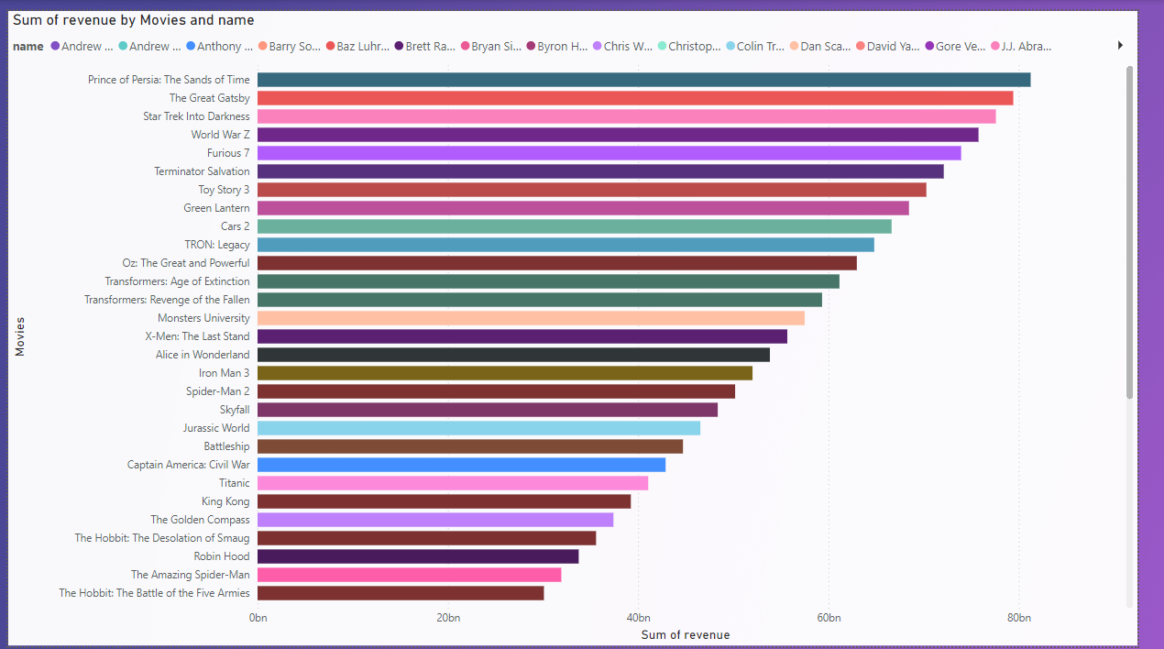
REVENUE GENRATED TO DIRECTOR AS PER MOVIES
This presentation analyzes how directors have influenced the financial success of blockbuster films. The data reveals key patterns in high-revenue films and the direct correlation between director styles and box office performance.

Slide 27
Name | Sum of revenue | Title | Name2 | Sum of revenue3 | Title4
Mike Newell | 81,25,24,28,915 | Prince of Persia: The Sands of Time | Peter Jackson | 39,23,22,31,914 | King Kong
Baz Luhrmann | 79,42,54,63,828 | The Great Gatsby | Chris Weitz | 37,40,52,66,827 | The Golden Compass
J.J. Abrams | 77,59,84,98,741 | Star Trek Into Darkness | Peter Jackson | 35,57,83,01,740 | The Hobbit: The Desolation of Smaug
Marc Forster | 75,77,15,33,654 | World War Z | Ridley Scott | 33,75,13,36,653 | Robin Hood
James Wan | 73,94,45,68,567 | Furious 7 | Marc Webb | 31,92,43,71,566 | The Amazing Spider-Man
McG | 72,11,76,03,480 | Terminator Salvation | Peter Jackson | 30,09,74,06,479 | The Hobbit: The Battle of the Five Armies
Lee Unkrich | 70,29,06,38,393 | Toy Story 3 | Barry Sonnenfeld | 28,27,04,41,392 | Men in Black 3
Martin Campbell | 68,46,36,73,306 | Green Lantern | Rob Marshall | 26,44,34,76,305 | Pirates of the Caribbean: On Stranger Tides
John Lasseter | 66,63,67,08,219 | Cars 2 | Joss Whedon | 24,61,65,11,218 | The Avengers
Joseph Kosinski | 64,80,97,43,132 | TRON: Legacy | Andrew Adamson | 22,78,95,46,131 | The Chronicles of Narnia: Prince Caspian
Sam Raimi | 62,98,27,78,045 | Oz: The Great and Powerful | Zack Snyder | 20,96,25,81,044 | Man of Steel
Michael Bay | 61,15,58,12,958 | Transformers: Age of Extinction | Gore Verbinski | 19,13,56,15,957 | The Lone Ranger
Michael Bay | 59,32,88,47,871 | Transformers: Revenge of the Fallen | Gore Verbinski | 17,30,86,50,870 | Pirates of the Caribbean: Dead Mans Chest"
Dan Scanlon | 57,50,18,82,784 | Monsters University | Marc Forster | 15,48,16,85,783 | Quantum of Solace
Brett Ratner | 55,67,49,17,697 | X-Men: The Last Stand | Bryan Singer | 13,65,47,20,696 | Superman Returns
Tim Burton | 53,84,79,52,610 | Alice in Wonderland | David Yates | 11,82,77,55,609 | Harry Potter and the Half-Blood Prince
Shane Black | 52,02,09,87,523 | Iron Man 3 | Joss Whedon | 10,00,07,90,522 | Avengers: Age of Ultron
Sam Raimi | 50,19,40,22,436 | Spider-Man 2 | Byron Howard | 8,17,38,25,435 | Tangled
Sam Mendes | 48,36,70,57,349 | Skyfall | Sam Raimi | 6,34,68,60,348 | Spider-Man 3
Colin Trevorrow | 46,54,00,92,262 | Jurassic World | Andrew Stanton | 4,51,98,95,261 | John Carter
Peter Berg | 44,71,31,27,175 | Battleship | James Cameron | 2,78,79,65,087 | Avatar
Anthony Russo | 42,88,61,62,088 | Captain America: Civil War | Christopher Nolan | 2,69,29,30,174 | The Dark Knight Rises
James Cameron | 41,05,91,97,001 | Titanic | Gore Verbinski | 96,10,00,000 | Pirates of the Caribbean: At Worlds End"
 |  |  | Sam Mendes | 86,59,65,087 | Spectre

Slide 28
Top Box Office Performers: Directors like Mike Newell, Baz Luhrmann, and J.J. Abrams have delivered massive blockbusters, with each contributing films that grossed billions. Peter Jackson emerges repeatedly with King Kong and The Hobbit, underscoring his influence in the fantasy genre.
Franchise Power: Sequel-driven franchises, such as Transformers, Pirates of the Caribbean, and The Hobbit, dominate the box office. These films show the high financial returns from established brands and fan-favorite characters.3
Action & Animation Domination: Directors like Michael Bay, Gore Verbinski, and Joss Whedon are known for action-packed films that appeal globally. Animation, too, contributes significantly to revenue with films like Toy Story 3 by Lee Unkrich.
Global Appeal: Films such as Avatar (James Cameron) and Jurassic World (Colin Trevorrow) highlight the importance of global appeal, drawing massive international audiences.
Director Influence: Prominent directors like James Cameron and Sam Mendes have proven that a strong narrative and star power are key drivers of box-office success, particularly in films with large-scale action and emotional depth.
The financial success of these directors and films reflects the growing dominance of franchises, action genres, and global storytelling. High-revenue films often stem from sequels, star-driven narratives, and international appeal, showing that the right combination of director, genre, and story can lead to record-breaking box-office earnings.

Slide 29
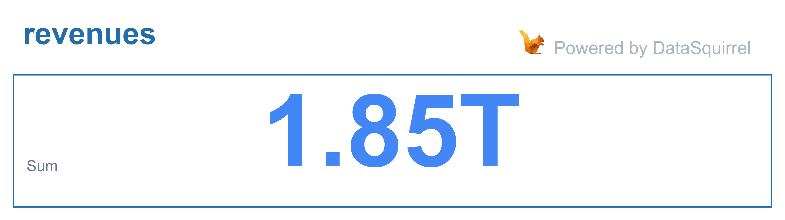

TOTAL REVENUE TO TOTAL BUGET

Slide 30
CONCLUSION
The financial success of blockbuster films is deeply influenced by the vision and direction of their respective filmmakers. Directors who bring a unique blend of storytelling, spectacle, and character depth tend to dominate the global box office. High-grossing films often emerge from established franchises, where directors can build on existing fan bases and deliver sequels that evolve with audience expectations. Directors like Peter Jackson, Michael Bay, and Joss Whedon have proven that action-packed, franchise-driven narratives are key to unlocking massive revenues.
On the other hand, directors who infuse their films with emotional depth and innovative visuals, like Baz Luhrmann and Lee Unkrich, demonstrate that even non-action genres such as drama and animation can achieve extraordinary success. Ultimately, a director's style, the franchise potential, and the global appeal of the story all play crucial roles in determining a film's box office success, proving that while visual spectacle and high action are important, a strong narrative and emotional connection with the audience are equally vital for creating timeless, lucrative blockbusters.

Slide 31
THANKYOU

